Slide 1
Principles of learning and how they apply to training

Slide 2
Jessica Lindvall Patricia Palagi

Slide 3
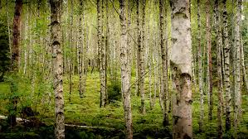

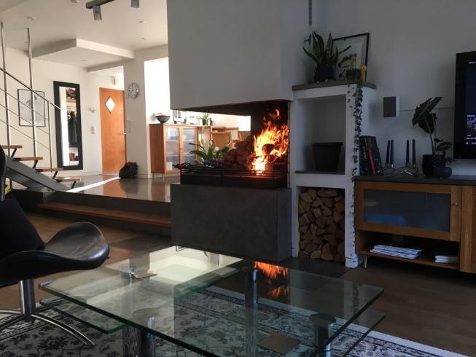
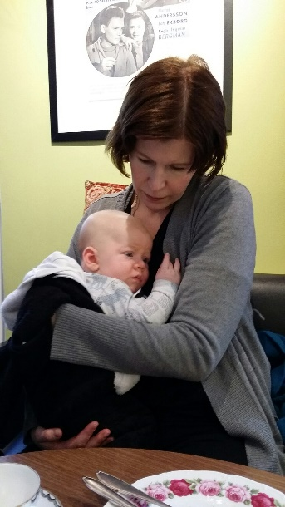

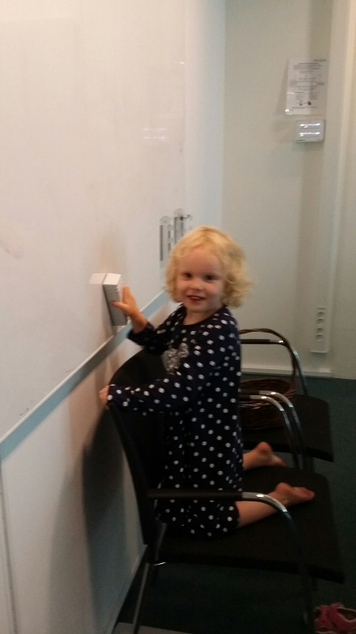



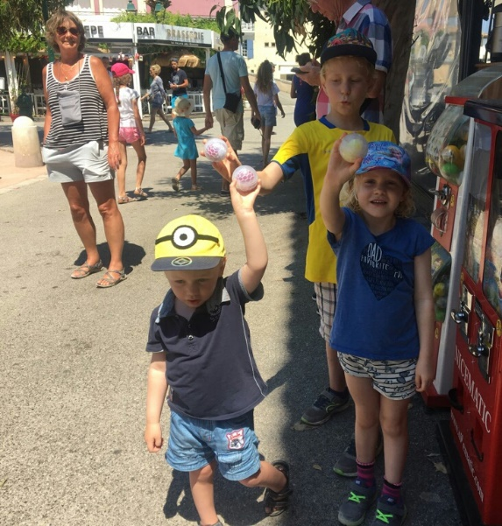
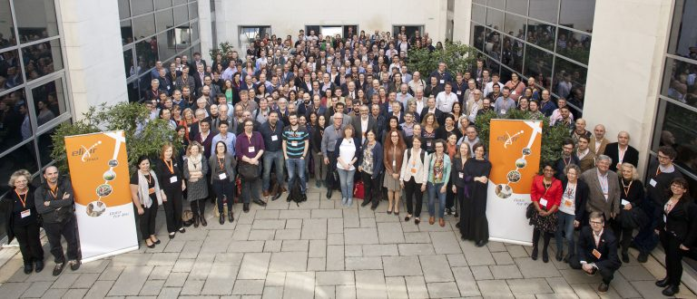
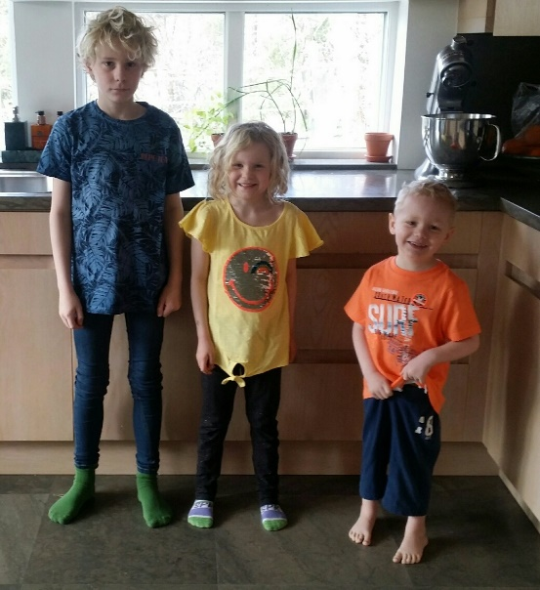




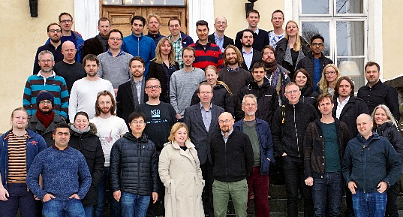
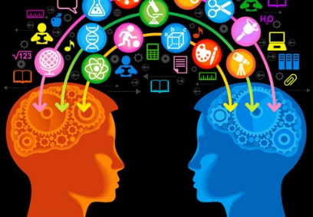
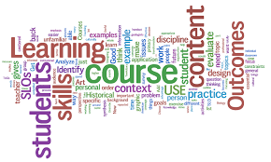
TREES/FOREST/NATURE
HOME
FAMILY
WORK
FRIENDS
DREAM

Slide 4

ELIXIR-EXCELERATE Train The Trainer

Slide 5
Why are we here?
Learning principles
Training techniques
Lesson, session, course, and material design
Assessment and feedback
Notes:
To get acquainted with learning principles and how they apply to training
To be able to select and utilise training techniques that can be used to enhance learner engagement and participation
To learn about session, course, and materials design
To learn how to use assessment and feedback in training

Slide 6
Session 1: Principles of learning and how they apply to training
Session 2: Training techniques that can be used to enhance learner engagement and participation
Session 3: Session, course, and materials design
Session 4: Assessment and feedback in training

Slide 7
Learning results from what the student does and thinks and only from what the student does and thinks. The teacher can advance learning only by influencing what the student does to learn
H.A. Simon (one of the founders of the field of
Cognitive Science and Nobel Laureate) 1916-2001
Notes:
Nobel laureate 1978 in Economics
His research was noted for its interdisciplinary nature and spanned across the fields of cognitive science, computer science, public administration, management, and political science

Slide 8
We cannot talk about teaching, teaching practices or effective teaching techniques if we don't understand first how people learn

Slide 9
How learning works
Challenge: How do you go about learning something new ? How do you approach learning new things? (3 min + 5 min)
Read about it
Attend a training session !
Have a go ?
Do, reflect, process, further understand?
Which is the most effective approach for *you* to learn?
Make a list of three approaches that work for you when you want to learn something new (from the most to the less effective one). Discuss it with your partner and compare.

Slide 10
What is learning?
From Ambrose et al. (2010) "How learning works":
Learning is not a product but a process occurring in the mind. As such, we can only infer that it has occurred from students' products or performance
Learning involves change in knowledge, beliefs, behaviours, or attitudes
Learning is not something done to students, but rather something students themselves do.
From Willingham (2009) "Why don't students like school?":
Learning is a change in the long term memory

Slide 11
What is learning?
From Ambrose et al. (2010) "How learning works":
Learning is not a product but a process occurring in the mind. As such, we can only infer that it has occurred from students' products or performance
Learning involves change in knowledge, beliefs, behaviours, or attitudes
Learning is not something done to students, but rather something students themselves do.
From Willingham (2009) "Why don't students like school?":
Learning is a change in the long term memory

Slide 12
What is learning?
From Ambrose et al. (2010) "How learning works":
Learning is not a product but a process occurring in the mind. As such, we can only infer that it has occurred from students' products or performance
Learning involves change in knowledge, beliefs, behaviours, or attitudes
Learning is not something done to students, but rather something students themselves do.
From Willingham (2009) "Why don't students like school?":
Learning is a change in the long term memory

Slide 13
What is learning?
From Ambrose et al. (2010) "How learning works":
Learning is not a product but a process occurring in the mind. As such, we can only infer that it has occurred from students' products or performance
Learning involves change in knowledge, beliefs, behaviours, or attitudes
Learning is not something done to students, but rather something students themselves do.
From Willingham (2009) "Why don't students like school?":
Learning is a change in the long term memory

Slide 14
How learning works
What is learning?
Which learning theory?

Slide 15
How learning works: Seven research-based principles for smart teaching (Ambrose, et al. 2010)
Principle P1: Students' prior knowledge can help or hinder learning.
Principle P2: How students organise knowledge influences how they learn and apply what they know.
Principle P3: Students motivation determines, directs and sustains what they do learn.
Principle P4: To develop mastery, students must acquire component skills, practice integrating them, and know when to apply what they have learned
Principle P5: Goal-directed practice coupled with targeted feedback enhances the quality of students' learning
Principle P6: Students' current level of development interacts with the social, emotional, and intellectual climate of the course to impact learning
Principle P7: To become self-directd leaners, students must learn to monitor and adjust their approaches to learning.

Slide 16
How learning works: Seven research-based principles for smart teaching (Ambrose, et al. 2010)
Principle P1: Students' prior knowledge can help or hinder learning.
Principle P2: How students organise knowledge influences how they learn and apply what they know.
Principle P3: Students motivation determines, directs and sustains what they do learn.
Principle P4: To develop mastery, students must acquire component skills, practice integrating them, and know when to apply what they have learned
Principle P5: Goal-directed practice coupled with targeted feedback enhances the quality of students' learning
Principle P6: Students' current level of development interacts with the social, emotional, and intellectual climate of the course to impact learning
Principle P7: To become self-directd leaners, students must learn to monitor and adjust their approaches to learning.

Slide 17
How learning works: Seven research-based principles for smart teaching (Ambrose, et al. 2010)
Principle P1: Students' prior knowledge can help or hinder learning.
Principle P2: How students organise knowledge influences how they learn and apply what they know.
Principle P3: Students motivation determines, directs and sustains what they do learn.
Principle P4: To develop mastery, students must acquire component skills, practice integrating them, and know when to apply what they have learned
Principle P5: Goal-directed practice coupled with targeted feedback enhances the quality of students' learning
Principle P6: Students' current level of development interacts with the social, emotional, and intellectual climate of the course to impact learning
Principle P7: To become self-directd leaners, students must learn to monitor and adjust their approaches to learning.

Slide 18
How learning works: Seven research-based principles for smart teaching (Ambrose, et al. 2010)
Principle P1: Students' prior knowledge can help or hinder learning.
Principle P2: How students organise knowledge influences how they learn and apply what they know.
Principle P3: Students motivation determines, directs and sustains what they do learn.
Principle P4: To develop mastery, students must acquire component skills, practice integrating them, and know when to apply what they have learned
Principle P5: Goal-directed practice coupled with targeted feedback enhances the quality of students' learning
Principle P6: Students' current level of development interacts with the social, emotional, and intellectual climate of the course to impact learning
Principle P7: To become self-directd leaners, students must learn to monitor and adjust their approaches to learning.

Slide 19
How learning works: Seven research-based principles for smart teaching (Ambrose, et al. 2010)
Principle P1: Students' prior knowledge can help or hinder learning.
Principle P2: How students organise knowledge influences how they learn and apply what they know.
Principle P3: Students motivation determines, directs and sustains what they do learn.
Principle P4: To develop mastery, students must acquire component skills, practice integrating them, and know when to apply what they have learned
Principle P5: Goal-directed practice coupled with targeted feedback enhances the quality of students' learning
Principle P6: Students' current level of development interacts with the social, emotional, and intellectual climate of the course to impact learning
Principle P7: To become self-directd leaners, students must learn to monitor and adjust their approaches to learning.

Slide 20
How learning works: Seven research-based principles for smart teaching (Ambrose, et al. 2010)
Principle P1: Students' prior knowledge can help or hinder learning.
Principle P2: How students organise knowledge influences how they learn and apply what they know.
Principle P3: Students motivation determines, directs and sustains what they do learn.
Principle P4: To develop mastery, students must acquire component skills, practice integrating them, and know when to apply what they have learned
Principle P5: Goal-directed practice coupled with targeted feedback enhances the quality of students' learning
Principle P6: Students' current level of development interacts with the social, emotional, and intellectual climate of the course to impact learning
Principle P7: To become self-directd leaners, students must learn to monitor and adjust their approaches to learning.

Slide 21
How learning works: Seven research-based principles for smart teaching (Ambrose, et al. 2010)
Principle P1: Students' prior knowledge can help or hinder learning.
Principle P2: How students organise knowledge influences how they learn and apply what they know.
Principle P3: Students motivation determines, directs and sustains what they do learn.
Principle P4: To develop mastery, students must acquire component skills, practice integrating them, and know when to apply what they have learned
Principle P5: Goal-directed practice coupled with targeted feedback enhances the quality of students' learning
Principle P6: Students' current level of development interacts with the social, emotional, and intellectual climate of the course to impact learning
Principle P7: To become self-directd leaners, students must learn to monitor and adjust their approaches to learning.

Slide 22
Our pedagogical model is based on the following concepts, ideas, and models:
The difference between teaching and training
Adult learning or andragogy
The Bloom's six categories of cognitive skills
How thinking and memory work
The acquisition of skills: novices, competent practicionners, experts
Cognitive development and mental models
The importance of the learning environment
Active learning

Slide 23
Teaching or Training?
Challenge: Based on your experience, what are in your opinion the differences between teaching and training? (5 min)
Make a list of three main differences. Discuss with your partner(s). Write in the Etherpad

Slide 24
Adult learning or andragogy
Challenge: what learner are you today?
Think about your experience as a learner when you were at school, and the learner you are now in this course.
Write one thing in which you feel different as a learner today from the learner you were at school.
Write it in Etherpad

Slide 25
Compared to children, adults:
are internally motivated
prefer to be active in decisions relating to their learning
they bring a lot of prior knowledge and experience to learning
need to have new knowledge linked with existing information
are goal-oriented (so learning for learning's sake is unsatisfactory) prefer learning what is authentic and directly relevant to their work or existing interests
are more practical learners, wanting to be able to apply what is learned
prefer to be treated as partners in the learning experience

Slide 26
Compared to children, adults:
are internally motivated
prefer to be active in decisions relating to their learning
they bring a lot of prior knowledge and experience to learning
need to have new knowledge linked with existing information
are goal-oriented (so learning for learning's sake is unsatisfactory) prefer learning what is authentic and directly relevant to their work or existing interests
are more practical learners, wanting to be able to apply what is learned
prefer to be treated as partners in the learning experience

Slide 27
Compared to children, adults:
are internally motivated
prefer to be active in decisions relating to their learning
they bring a lot of prior knowledge and experience to learning
need to have new knowledge linked with existing information
are goal-oriented (so learning for learning's sake is unsatisfactory) prefer learning what is authentic and directly relevant to their work or existing interests
are more practical learners, wanting to be able to apply what is learned
prefer to be treated as partners in the learning experience

Slide 28
Compared to children, adults:
are internally motivated
prefer to be active in decisions relating to their learning
they bring a lot of prior knowledge and experience to learning
need to have new knowledge linked with existing information
are goal-oriented (so learning for learning's sake is unsatisfactory) prefer learning what is authentic and directly relevant to their work or existing interests
are more practical learners, wanting to be able to apply what is learned
prefer to be treated as partners in the learning experience

Slide 29
Compared to children, adults:
are internally motivated
prefer to be active in decisions relating to their learning
they bring a lot of prior knowledge and experience to learning
need to have new knowledge linked with existing information
are goal-oriented (so learning for learning's sake is unsatisfactory) prefer learning what is authentic and directly relevant to their work or existing interests
are more practical learners, wanting to be able to apply what is learned
prefer to be treated as partners in the learning experience

Slide 30
Compared to children, adults:
are internally motivated
prefer to be active in decisions relating to their learning
they bring a lot of prior knowledge and experience to learning
need to have new knowledge linked with existing information
are goal-oriented (so learning for learning's sake is unsatisfactory) prefer learning what is authentic and directly relevant to their work or existing interests
are more practical learners, wanting to be able to apply what is learned
prefer to be treated as partners in the learning experience

Slide 31
Compared to children, adults:
are internally motivated
prefer to be active in decisions relating to their learning
they bring a lot of prior knowledge and experience to learning
need to have new knowledge linked with existing information
are goal-oriented (so learning for learning's sake is unsatisfactory) prefer learning what is authentic and directly relevant to their work or existing interests
are more practical learners, wanting to be able to apply what is learned
prefer to be treated as partners in the learning experience

Slide 32
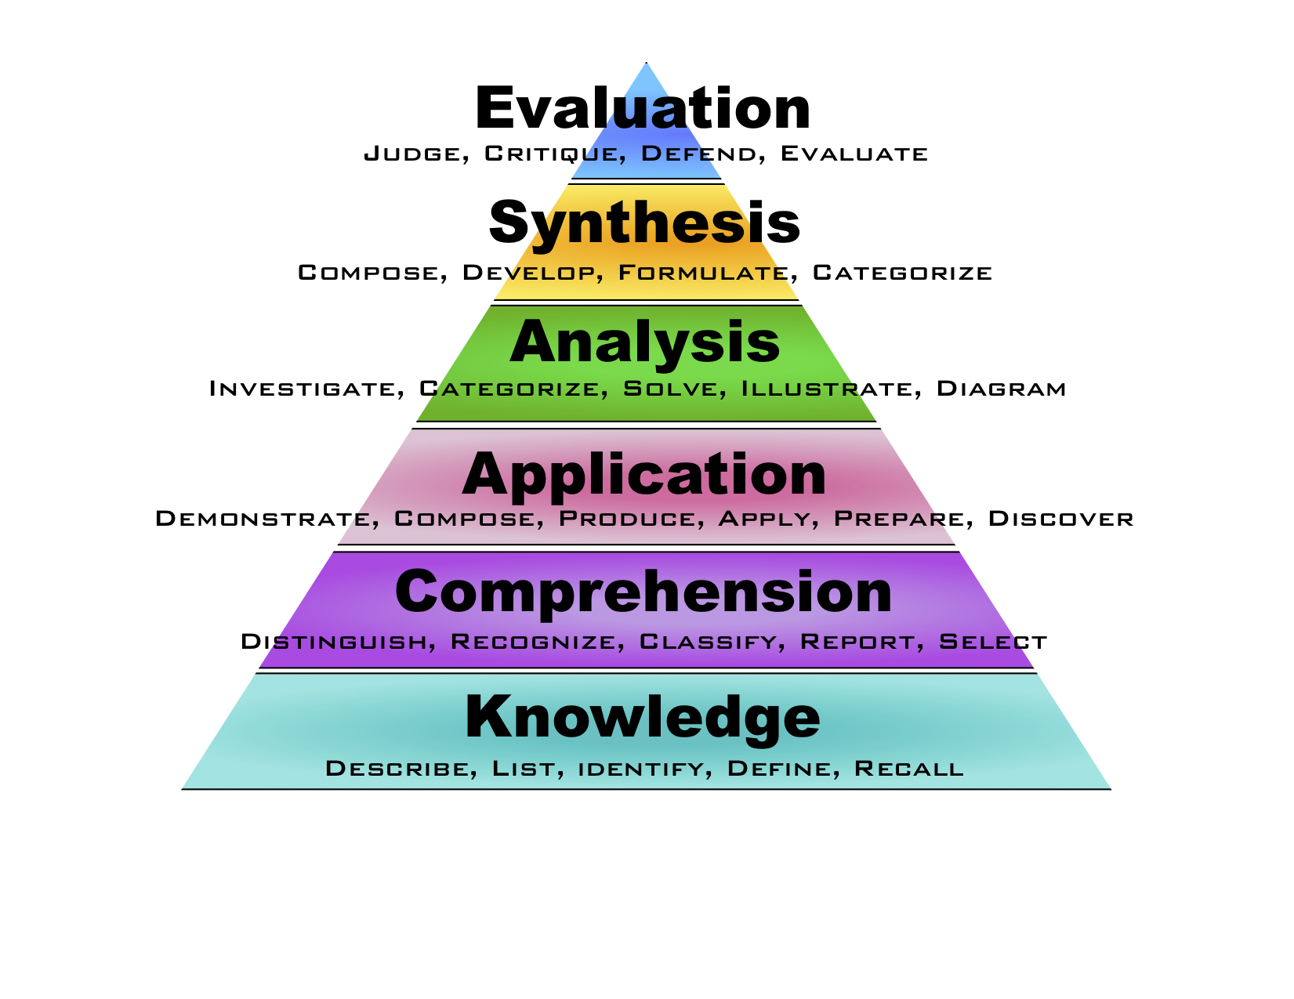
The Bloom's six categories of cognitive skills

Slide 33
The Bloom's six categories of cognitive skills
1. Remember/Reiterate - performance is based on recognition of a seen example(s);
2. Understand/Summarise - performance summarizes information already known/given;
3. Apply/Illustrate - performance extrapolates from seen examples to new ones by applying rules;
4. Analyze/Predict - performance requires analysis and prediction, using rules;
5. Create/ Synthetise - performance yields something innovative and novel, creating, describing and justifying something new from existing things/ideas;

Slide 34
How can we use the Bloom's hierarchy of cognitive skills in teaching and training?
We can use the Bloom's taxonomy to align instruction with learners' levels of complexity of thinking (and experience).
How? We can use it to:
identify teaching objectives and learning outcomes
design instruction and learning experiences
assess learning

Slide 35
How can we use the Bloom's hierarchy of cognitive skills in teaching and training?
We can use the Bloom's taxonomy to align instruction with learners' levels of complexity of thinking (and experience).
How? We can use it to:
identify teaching objectives and learning outcomes
design instruction and learning experiences
assess learning

Slide 36
Teaching objectives and Learning Outcomes

Slide 37
In order to write learning outcomes, you can use the following scheme:
1) Think about what learners will be able to do by the end of instruction
2) Use the sentence: By the end of the lesson (session/course/instruction) the learner will be able to......... OR The successful learner will be able to......
3) Replace dots with a verb that you can assess (name, explain, solve, distinguish, etc.).
4) Avoid verbs that are open to many interpretations: appreciate, have faith in, know, learn, understand, believe
5) Keep in mind that learning outcomes can be as specific as you want. You may even think about a different learning outcome for each task you assign to learners.

Slide 38
In order to write learning outcomes, you can use the following scheme:
1) Think about what learners will be able to do by the end of instruction
2) Use the sentence: By the end of the lesson (session/course/instruction) the learner will be able to......... OR The successful learner will be able to......
3) Replace dots with a verb that you can assess (name, explain, solve, distinguish, etc.).
4) Avoid verbs that are open to many interpretations: appreciate, have faith in, know, learn, understand, believe
5) Keep in mind that learning outcomes can be as specific as you want. You may even think about a different learning outcome for each task you assign to learners.

Slide 39
In order to write learning outcomes, you can use the following scheme:
1) Think about what learners will be able to do by the end of instruction
2) Use the sentence: By the end of the lesson (session/course/instruction) the learner will be able to......... OR The successful learner will be able to......
3) Replace dots with a verb that you can assess (name, explain, solve, distinguish, etc.).
4) Avoid verbs that are open to many interpretations: appreciate, have faith in, know, learn, understand, believe
5) Keep in mind that learning outcomes can be as specific as you want. You may even think about a different learning outcome for each task you assign to learners.

Slide 40
In order to write learning outcomes, you can use the following scheme:
1) Think about what learners will be able to do by the end of instruction
2) Use the sentence: By the end of the lesson (session/course/instruction) the learner will be able to......... OR The successful learner will be able to......
3) Replace dots with a verb that you can assess (name, explain, solve, distinguish, etc.).
4) Avoid verbs that are open to many interpretations: appreciate, have faith in, know, learn, understand, believe
5) Keep in mind that learning outcomes can be as specific as you want. You may even think about a different learning outcome for each task you assign to learners.

Slide 41
In order to write learning outcomes, you can use the following scheme:
1) Think about what learners will be able to do by the end of instruction
2) Use the sentence: By the end of the lesson (session/course/instruction) the learner will be able to......... OR The successful learner will be able to......
3) Replace dots with a verb that you can assess (name, explain, solve, distinguish, etc.).
4) Avoid verbs that are open to many interpretations: appreciate, have faith in, know, learn, understand, believe
5) Keep in mind that learning outcomes can be as specific as you want. You may even think about a different learning outcome for each task you assign to learners.

Slide 42
Measurable verbs to assist you in writing and assessing learning outcomes
https://github.com/ppalagi/EXCELERATE-TtT/blob/master/docs/learning-outcomes.md

Slide 43
Teaching objectives and Learning Outcomes
Challenge
Write a Teaching Objective AND a Learning Outcome for a lesson or a session you usually deliver.

Slide 44
The acquisition of skills: novice, competent practicionner, expert

Slide 45
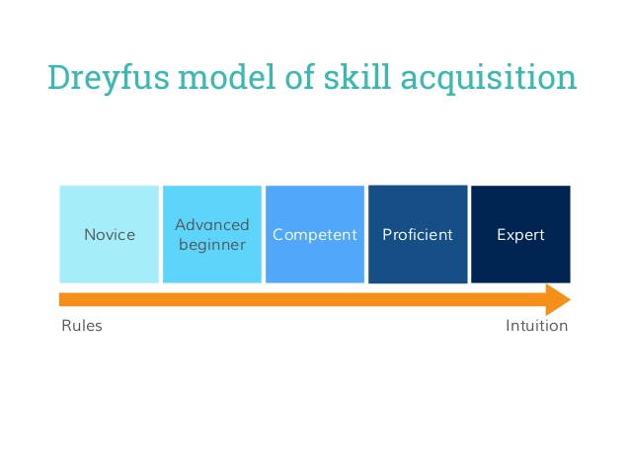

Slide 46
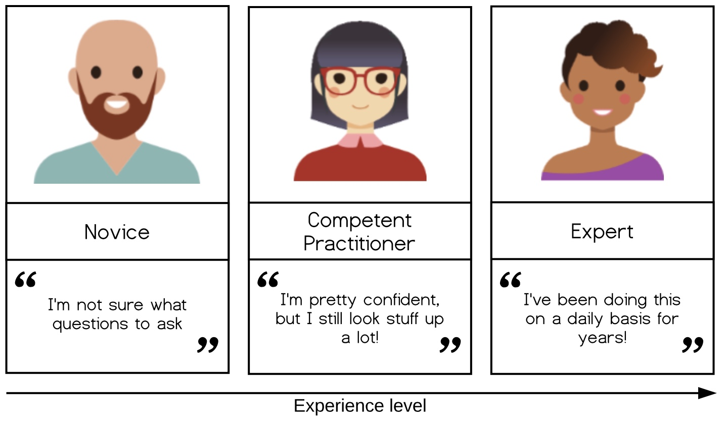

Slide 47
The acquisition of skills: novice, competent practicionner, expert
Novice: someone who doesn’t even know what questions to ask
Competent practitioner: someone who has enough understanding for everyday purposes
Expert: someone who can easily handle situations that are out of the ordinary

Slide 48
The acquisition of skills: novice, competent practicionner, expert
Challenge
Think about a topic/field you feel you are a novice, a topic you feel you are a competent practitioner, and one you feel an expert, and share this with us.

Slide 49
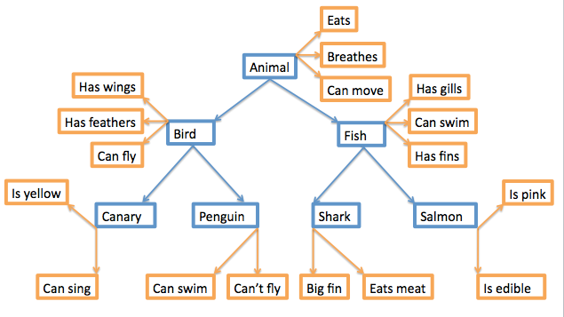
Mental models
A mental model is a collection of concepts and facts, along with the relationships between those concepts, that a person has about a topic or field.

Slide 50
Novice, competent practitioner, expert: in what do they differ?
Challenge: What are the main differences between a novice and an expert in terms of knowledge and learning?
Think about yourself as a learner.
How did you feel about something new when you were a student? How was to be a novice? Can you remember it?
How do you feel today when you have/want to learn something completely new to you? Does it happen sometimes?
How do you feel when you have to learn something new *in your field*? Namely, something that is an extension of your current knowledge about something (e.g. you know well a given OS and you need to learn how a different OS works).
Write at least two things in which novices and experts differ.

Slide 51
Learners' prior knowledge and misconceptions
P1: How can prior knowledge hinder learning?
Misconceptions
Simple factual errors
Broken models
Fundamental beliefs

Slide 52
Working memory, long term memory and learning
Attention
Working memory
(site of awareness and thinking)
Environment
Remembering
Learning
Long-term memory
(factual knowledge and procedural knowledge)

Slide 53
Working memory, long term memory and learning
Attention
Working memory
(site of awareness and thinking)
Environment
Component of your mind (synonymous of consciousness). It is where thinking occurs. It is the part of your mind where you are aware of what is around you.
Full of things to see and hear, problem to be solved etc.
Remembering
Learning
Long-term memory
(factual knowledge and procedural knowledge)
Vast storehouse in which you mantain your factual knowledge of the world. Information in long-term memory resides outside of awareness.

Slide 54
Long-term vs working memory
Long-term memory is slow to access but it is essentially unbounded
Working memory is very fast but has very limited space. Several experiments showed that we can hold in the working memory up to 7 +/- 2 items.
https://cat.xula.edu/thinker/memory/working/serial
The fact that working memory has limited space, implies that thinking becomes increasingly difficult as working memory gets crowded.

Slide 55
What can we do to make room in working memory?
Increase our background knowledge
Avoid extraneous cognitive load

Slide 56
X C N
N P H
D F B
I C I
A N C
A A X

Slide 58
X
C N N
P H D
F B I
C I A
N C A A
X

Slide 59
Other factors facilitating memory
things that create an emotional reaction will be better remembered, but emotion is not necessary for learning (and it is definitely not sufficient!)
if you don't pay attention to something, you can't learn it
repetition helps but repetition alone is not sufficient
wanting to remember something has little or no effect
thinking about meaning is good for memory
practice makes learning long lasting
spaced practice is of great benefit for memory

Slide 60
Other factors facilitating memory
things that create an emotional reaction will be better remembered, but emotion is not necessary for learning (and it is definitely not sufficient!)
if you don't pay attention to something, you can't learn it
repetition helps but repetition alone is not sufficient
wanting to remember something has little or no effect
thinking about meaning is good for memory
practice makes learning long lasting
spaced practice is of great benefit for memory

Slide 61
Other factors facilitating memory
things that create an emotional reaction will be better remembered, but emotion is not necessary for learning (and it is definitely not sufficient!)
if you don't pay attention to something, you can't learn it
repetition helps but repetition alone is not sufficient
wanting to remember something has little or no effect
thinking about meaning is good for memory
practice makes learning long lasting
spaced practice is of great benefit for memory

Slide 62
Other factors facilitating memory
things that create an emotional reaction will be better remembered, but emotion is not necessary for learning (and it is definitely not sufficient!)
if you don't pay attention to something, you can't learn it
repetition helps but repetition alone is not sufficient
wanting to remember something has little or no effect
thinking about meaning is good for memory
practice makes learning long lasting
spaced practice is of great benefit for memory

Slide 63
Other factors facilitating memory
things that create an emotional reaction will be better remembered, but emotion is not necessary for learning (and it is definitely not sufficient!)
if you don't pay attention to something, you can't learn it
repetition helps but repetition alone is not sufficient
wanting to remember something has little or no effect
thinking about meaning is good for memory
practice makes learning long lasting
spaced practice is of great benefit for memory

Slide 64
Other factors facilitating memory
things that create an emotional reaction will be better remembered, but emotion is not necessary for learning (and it is definitely not sufficient!)
if you don't pay attention to something, you can't learn it
repetition helps but repetition alone is not sufficient
wanting to remember something has little or no effect
thinking about meaning is good for memory
practice makes learning long lasting
spaced practice is of great benefit for memory

Slide 65
Other factors facilitating memory
things that create an emotional reaction will be better remembered, but emotion is not necessary for learning (and it is definitely not sufficient!)
if you don't pay attention to something, you can't learn it
repetition helps but repetition alone is not sufficient
wanting to remember something has little or no effect
thinking about meaning is good for memory
practice makes learning long lasting
spaced practice is of great benefit for memory

Slide 66
Cognitive load
Cognitive load refers to the total amount of mental effort being used in the working memory
Intrinsic cognitive load is the effort associated with a specific topic
Germane cognitive load is the (desirable) mental effort required to create linkages between new information and old (which is one of the things that distinguishes learning from memorisation)
Extraneous cognitive load is everything else that distracts or gets in the way.

Slide 67
Cognitive load
Cognitive load refers to the total amount of mental effort being used in the working memory
Intrinsic cognitive load is the effort associated with a specific topic
Germane cognitive load is the (desirable) mental effort required to create linkages between new information and old (which is one of the things that distinguishes learning from memorisation)
Extraneous cognitive load is everything else that distracts or gets in the way.

Slide 68
Cognitive load
Cognitive load refers to the total amount of mental effort being used in the working memory
Intrinsic cognitive load is the effort associated with a specific topic
Germane cognitive load is the (desirable) mental effort required to create linkages between new information and old (which is one of the things that distinguishes learning from memorisation)
Extraneous cognitive load is everything else that distracts or gets in the way.

Slide 69
Cognitive load
Cognitive load refers to the total amount of mental effort being used in the working memory
Intrinsic cognitive load is the effort associated with a specific topic
Germane cognitive load is the (desirable) mental effort required to create linkages between new information and old (which is one of the things that distinguishes learning from memorisation)
Extraneous cognitive load is everything else that distracts or gets in the way.

Slide 70
Split attention effect

Slide 71
The Learning Environment

Slide 72
Value
attainment value
satisfaction that one gains from mastery and accomplishment of a goal or task
intrinsic value
the satisfaction that one gains simply from doing the task rather than from a particular outcome of the task
It is the source of intrinsic motivation
instrumental value/extrinsic rewards
praise
public recognition
money
material goods
an interesting career
a high-status job, etc.)

Slide 73
Efficacy
positive outcomes expectancies for success
growth vs fixed mindset
Efficacy expetancies represent the belief that one is capable of identifying, organising, initiating, and executing a course of action that will bring about a desired outcome (Bandura, 1997).
In order to hold a positive expectancy for success, learners must not only believe that doing the assigned work can earn a passing grade (growth mindset), they must also believe that they are capable of doing the work necessary to earn a passing grade

Slide 74
Efficacy
positive outcomes expectancies for success
growth vs fixed mindset
Efficacy expetancies represent the belief that one is capable of identifying, organising, initiating, and executing a course of action that will bring about a desired outcome (Bandura, 1997).
In order to hold a positive expectancy for success, learners must not only believe that doing the assigned work can earn a passing grade (growth mindset), they must also believe that they are capable of doing the work necessary to earn a passing grade

Slide 75
Environment
complex dynamics of the classroom
its tone
the interpersonal forces at play
the nature and structure of communication patterns.
e.g. "The instructor is approachable and several of my classmates seem willing to help me if I run into troubles".

Slide 76
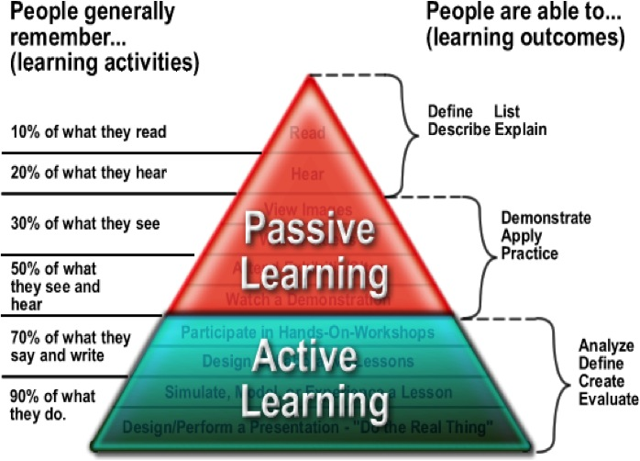

Slide 77
Mazur's video on Peer Instruction for Active Learning

